Slide 1


Slide 2
SERVICES & INITIATIVES
Emergency Response Services
Field Investigation Services
Laboratory Services
Air Services
Compliance Services
Permit Services
Water Services
Community Air Monitoring Program
Rapid Ambient Air Monitoring
Concrete Batch Plant Program
Community Conversations

Slide 3

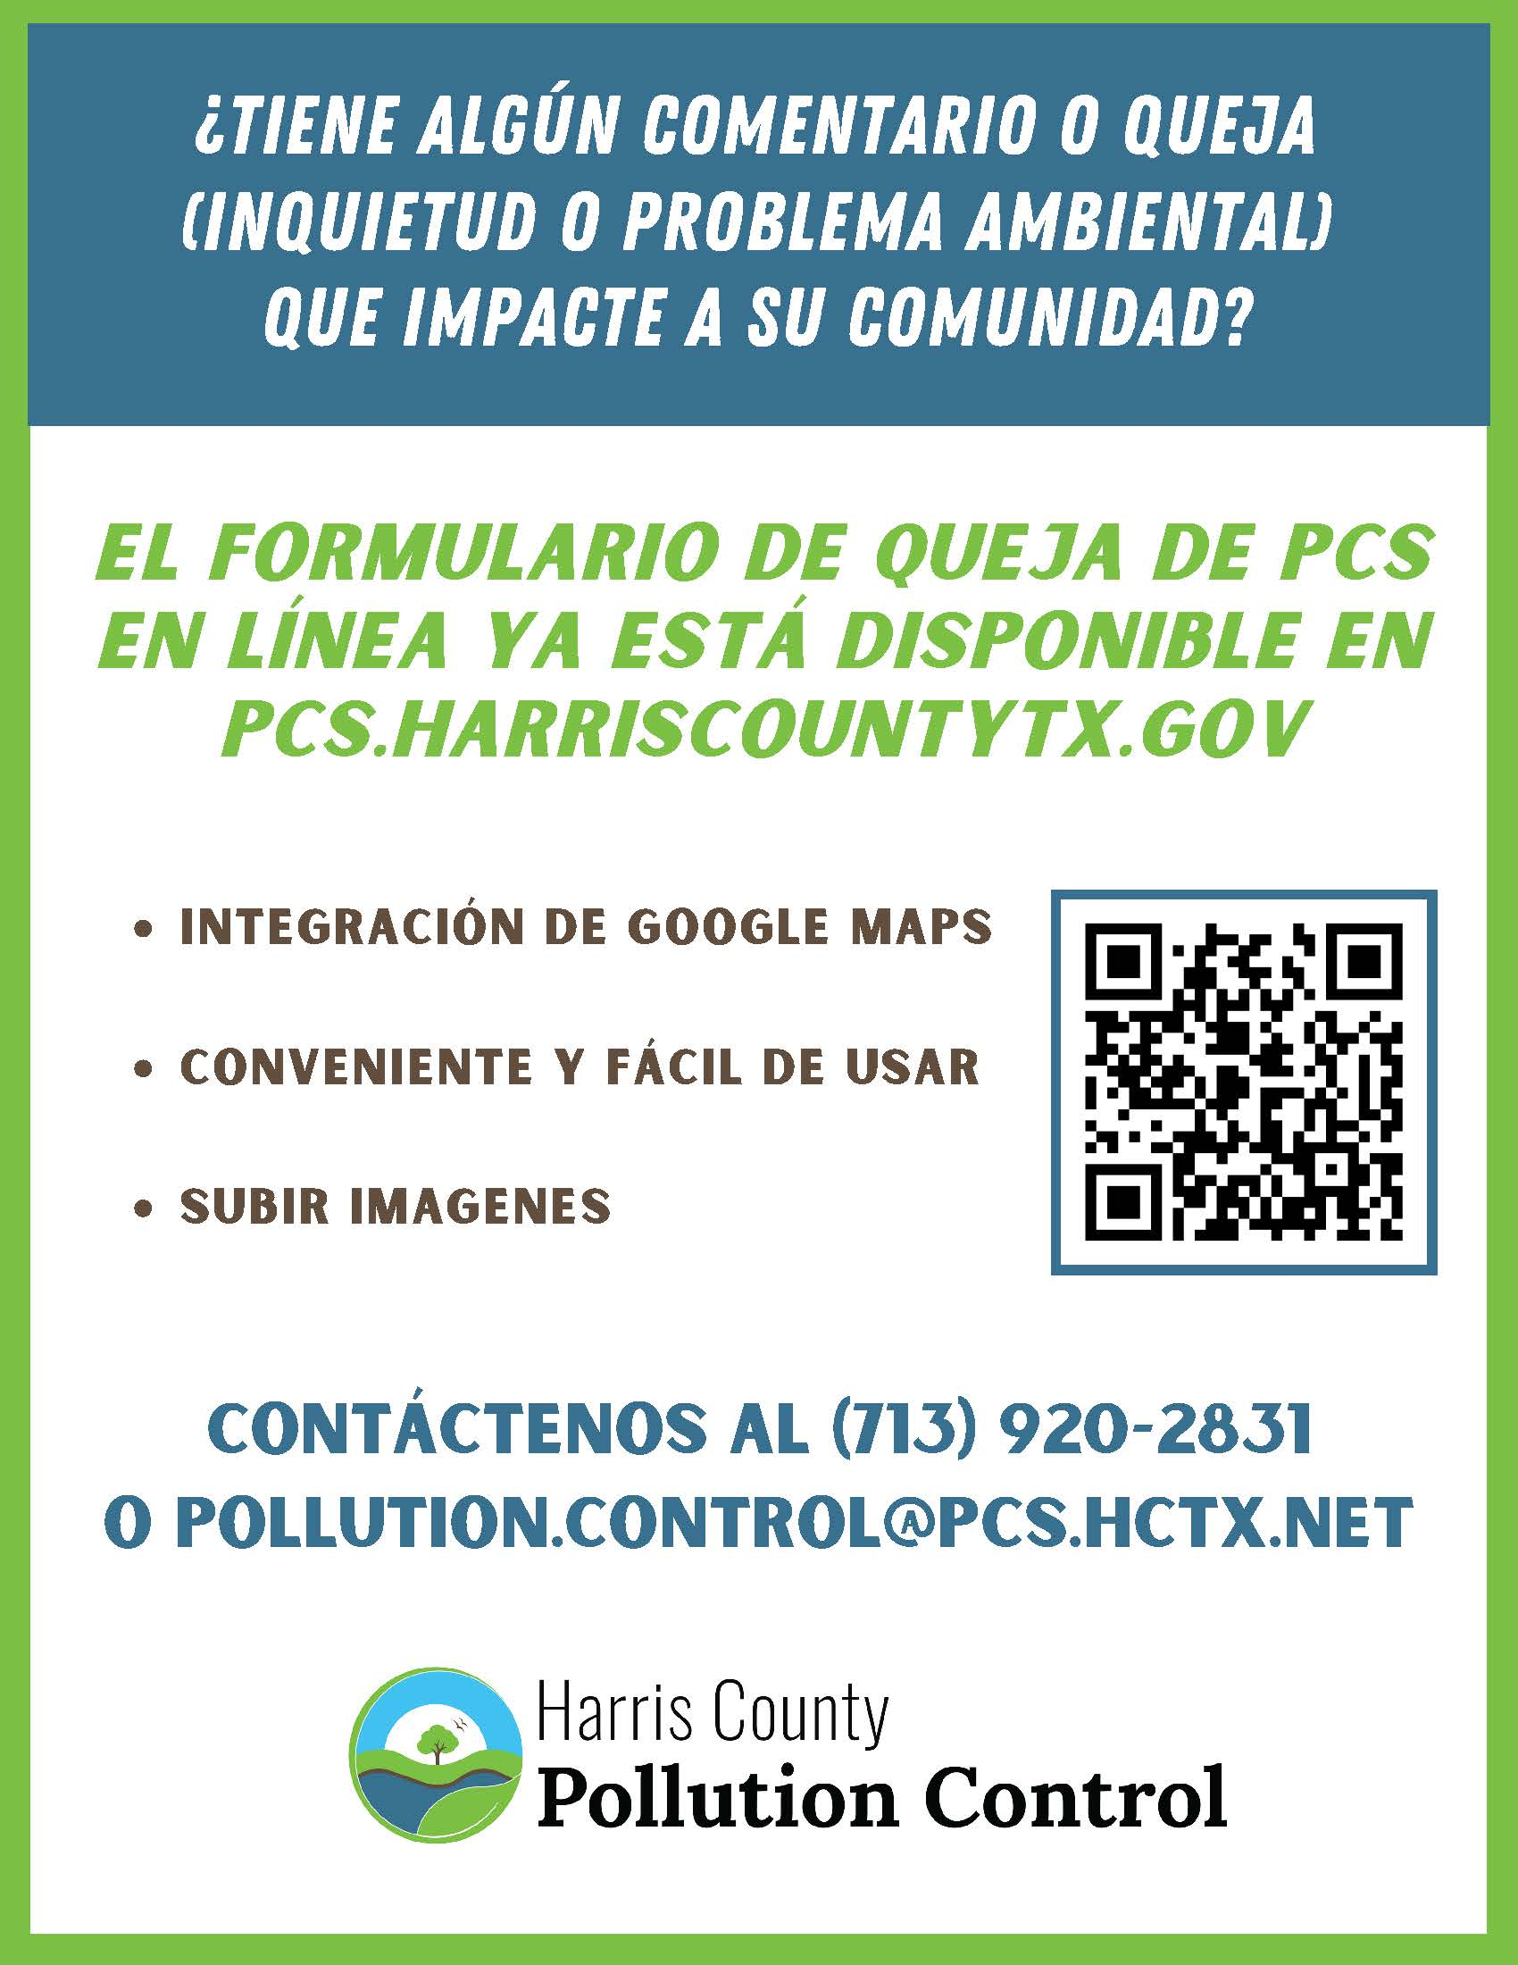
FILE A COMPLAINT

Slide 4




SOCIAL MEDIA
@HarrisCoPollutionControl
@harriscopc
@HarrisCoPC
Nextdoor

Slide 5
PCS DEPARTMENT
CONTACT INFORMATION
QUESTIONS? COMMENTS?
LET US KNOW!
ADDRESS
101 South Richey, Suite H Pasadena, Texas 77506
PHONE
713-920-2831 (PCS MAIN)
EMAIL
PCS-Communications@pcs.hctx.net
WEBSITE
Pcs.harriscountytx.gov
Harris County Pollution Control Services Department

